Slide 1
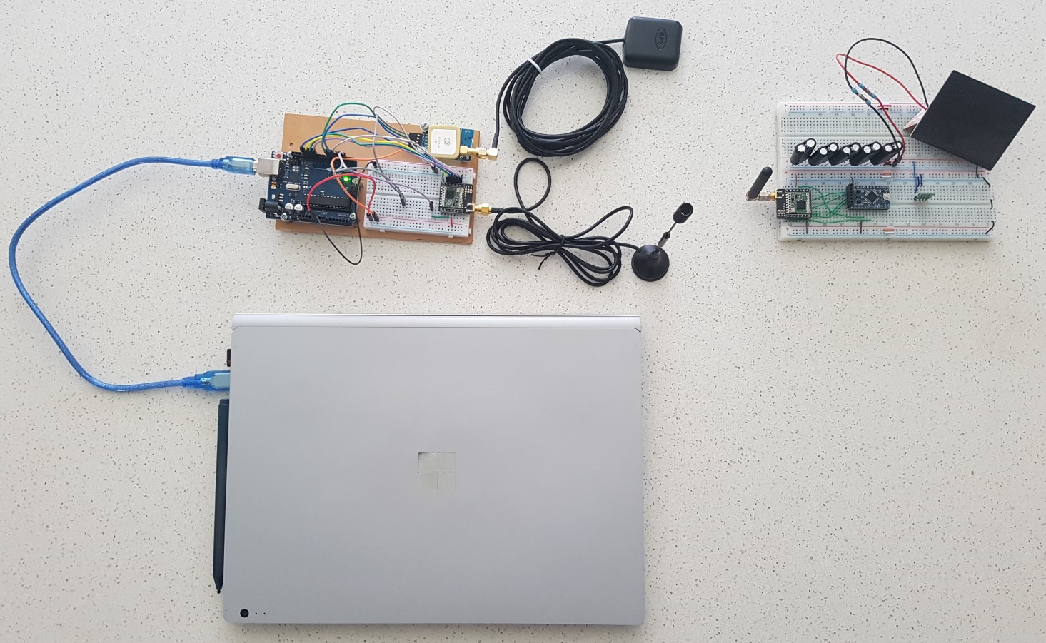
Design of a small satellite UHF radio beacon for Identification, Telemetry, Tracking and Control
Presented by Pilot Officer Travis McKee
Thesis Supervisors: Dr Edwin Peters & Dr Craig Benson
Notes:
Good morning/afternoon, my name is Pilot Officer McKee and I am to present my thesis project
The design of a small satellite UHF radio beacon for identification, telemetry, tracking and control.

Slide 2
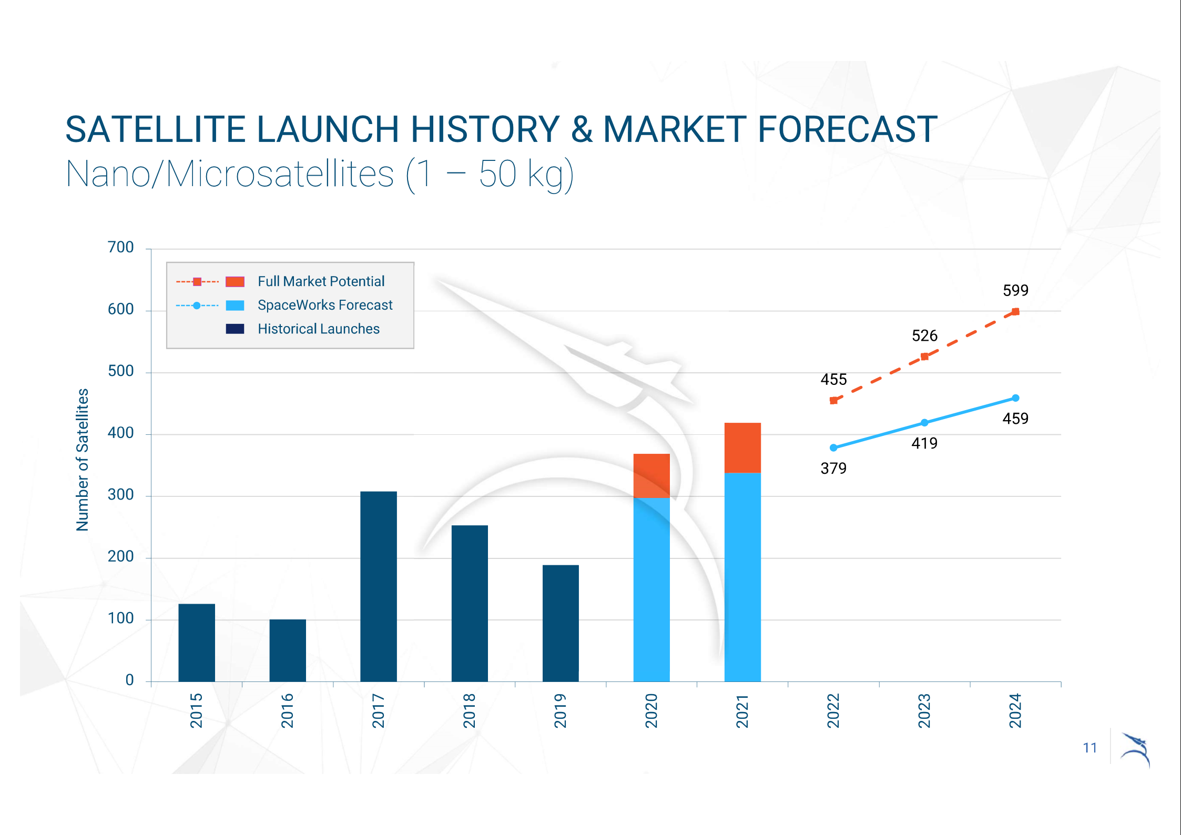
Introduction
“SpaceWorks estimates 1,800 – 2,400 nano/microsatellites will require launch over the next 5 years”
2020 Nano/Microsatellites market forecast, 10th Edition
Source: Space Works, 2020 Nano/Microsatellite market forecast, 10th edition,
Accessed at: https://www.spaceworks.aero/nano-microsatellite-forecast-10th-edition-2020/
Notes:
The Space Works market forecast estimates up to 2400 satellites will require launch into the Low Earth Orbit over the next 5 years.
This is due to a significant decrease in design, manufacture and launch costs.

Slide 3
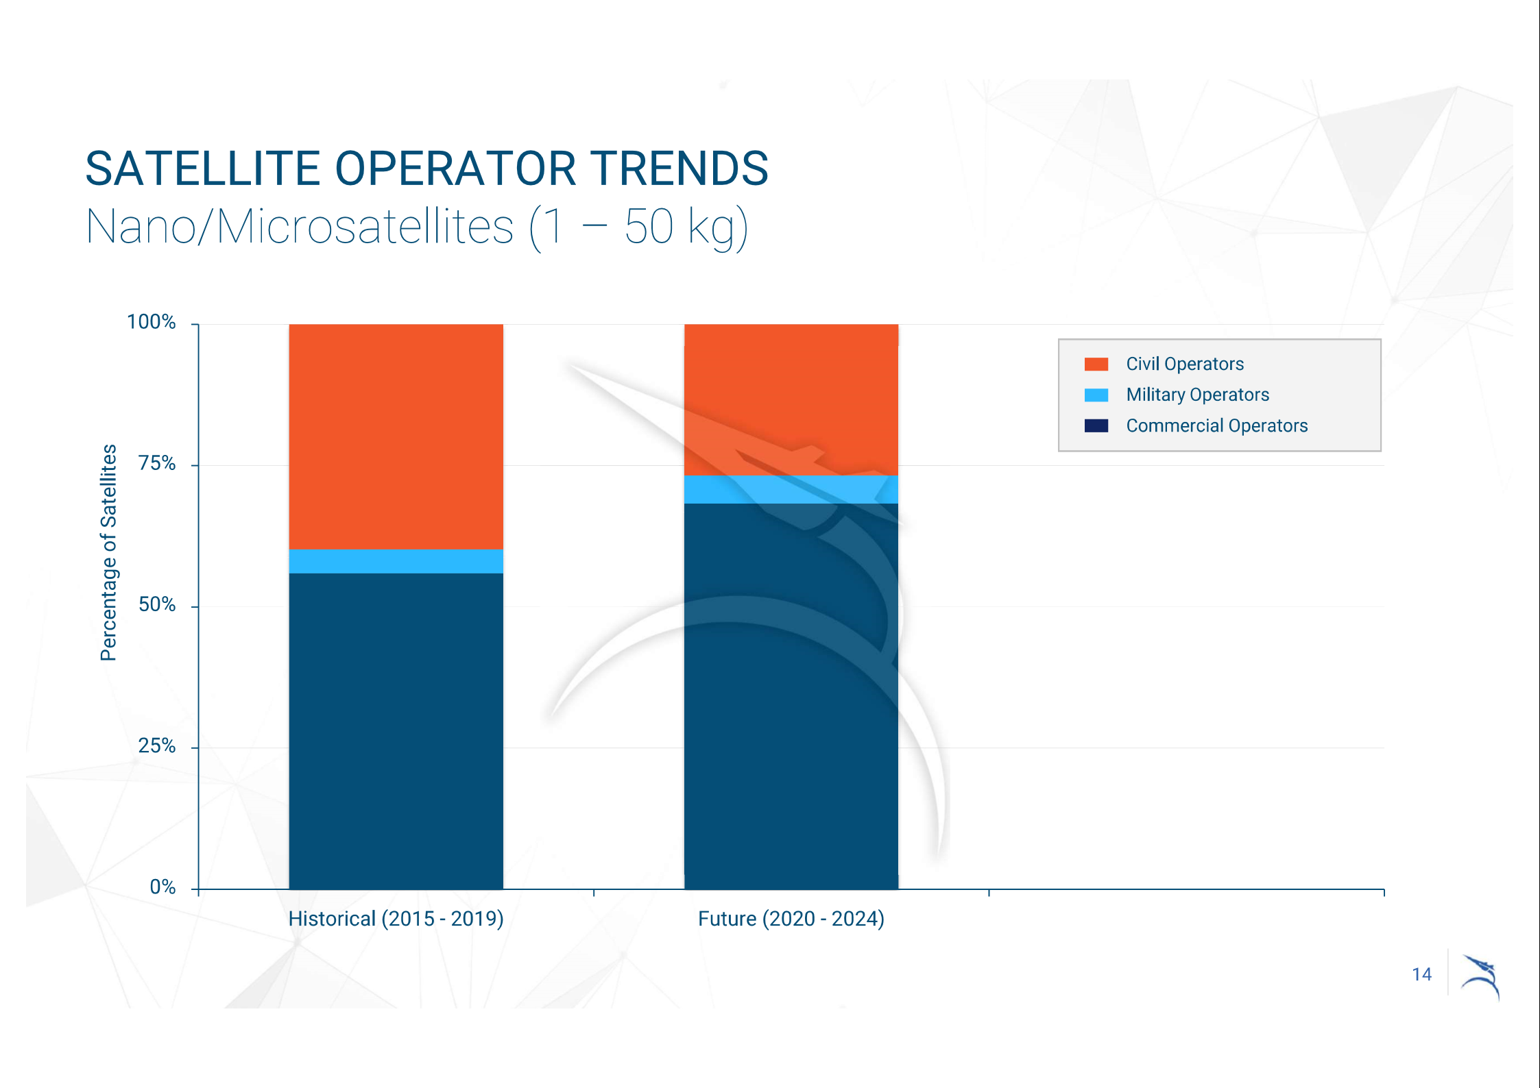
Introduction
“mission success rates average 45 percent and 77 percent between academia and industry, respectively”
U.S. Space program Mission Assurance Improvement Workshop
Source: Space Works, 2020 Nano/Microsatellite market forecast, 10th edition,
Accessed at: https://www.spaceworks.aero/nano-microsatellite-forecast-10th-edition-2020/
Notes:
A large portion of small satellites in the LEO environment are operated by organizations with little to no space experience.
This has resulted in a mission failure rate of 55% for academic institutions and 23% for commercial enterprises.

Slide 4
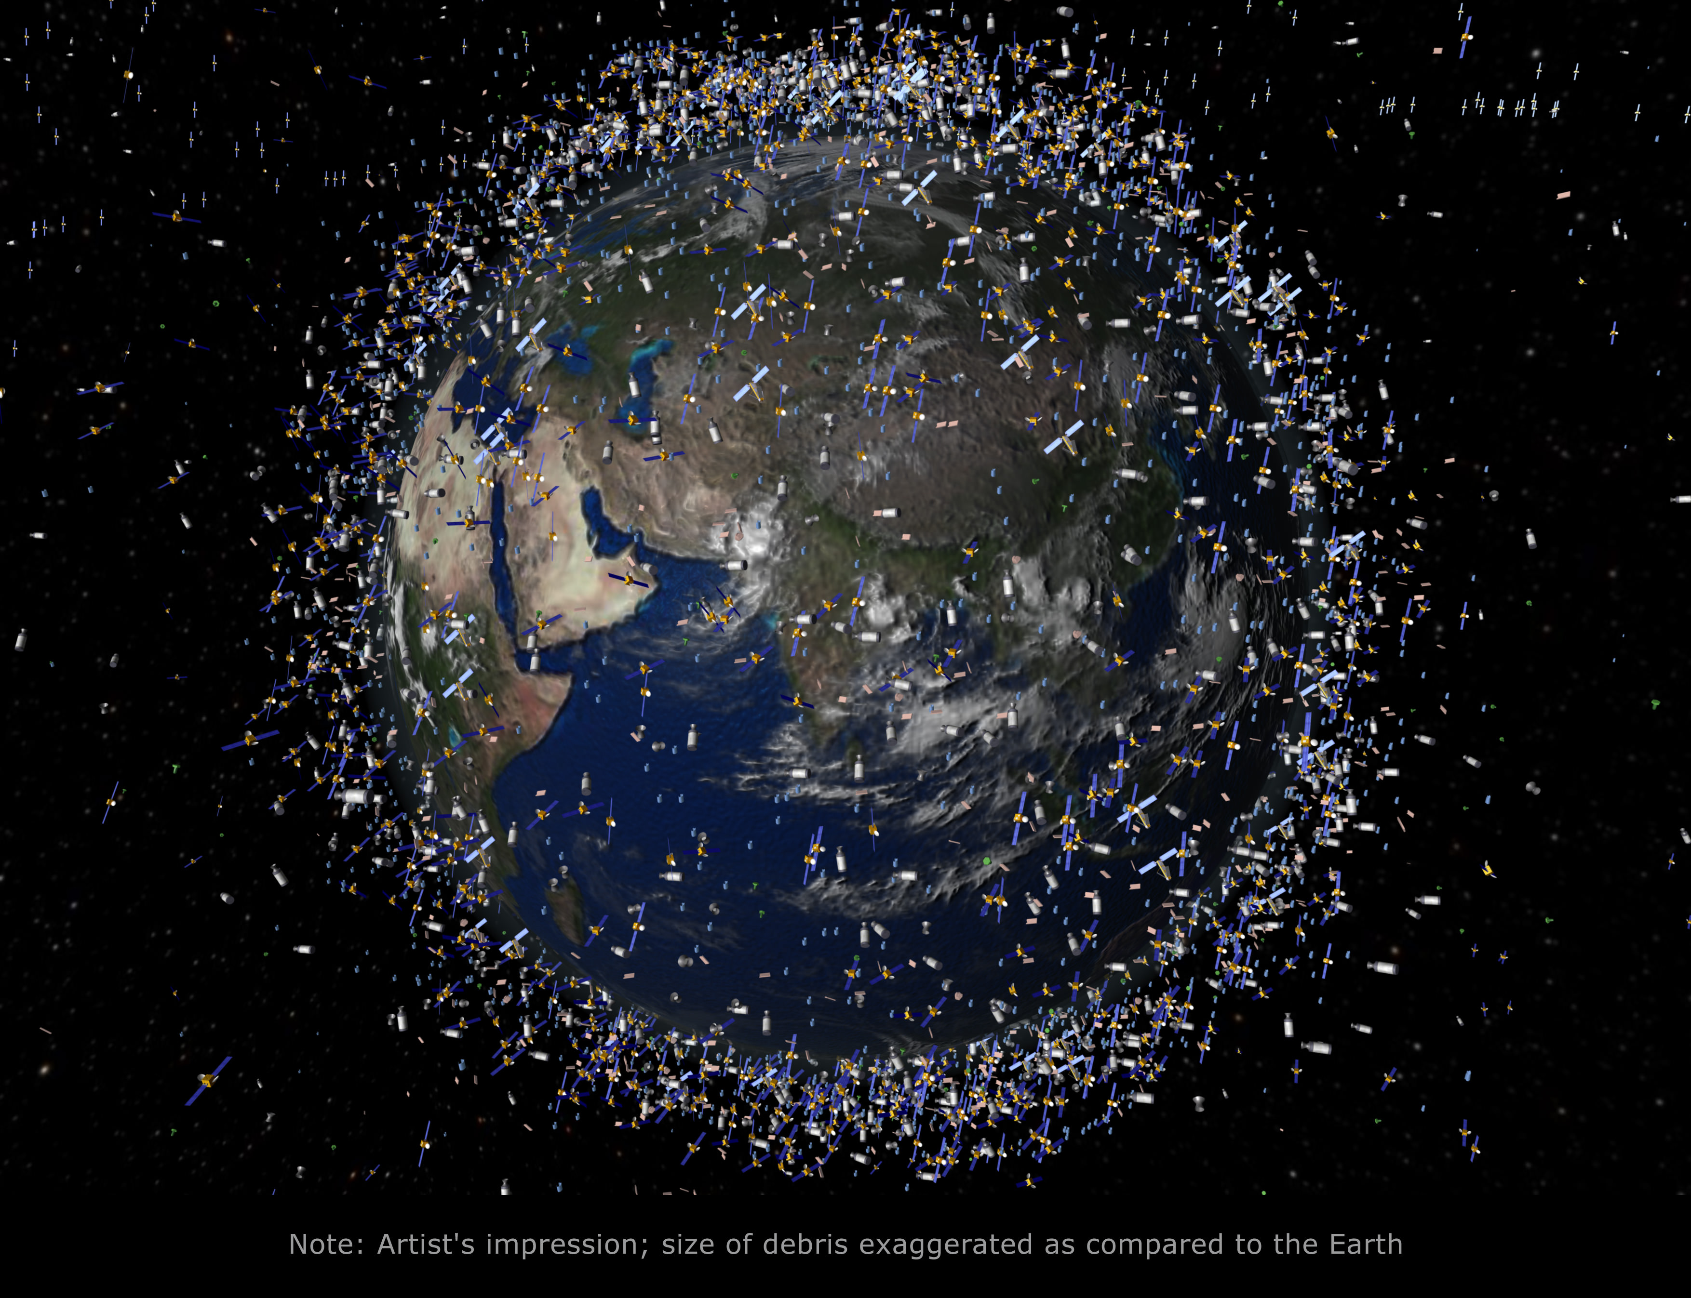
Introduction
Additional challenges for monitoring and operating in the Low Earth Orbit (LEO) environment:
Increased demand on resource expensive space monitoring equipment to maintain Space situational awareness (SSA)
A large failure rate of small satellites leading to an increase in space debris
Increased difficulties in identifying a small objects in the LEO environment
Image source: Universe Today, Space and astronomy news
Accessed at: https://www.universetoday.com/85322/what-is-low-earth-orbit/
Notes:
The previous two conditions outlined has produced additional challenges for space monitoring and operations due to the increased number of satellites and space debris in the LEO environment
The initial research has identified three problems to be addressed:
The increased demand on resource expensive space monitoring equipment to maintain Space Situational Awareness
The large failure rate of small satellites leading to an increase in space debris objects, with the cause of failure being unable to be determined
The increased difficulties in identifying an object in the LEO environment

Slide 5
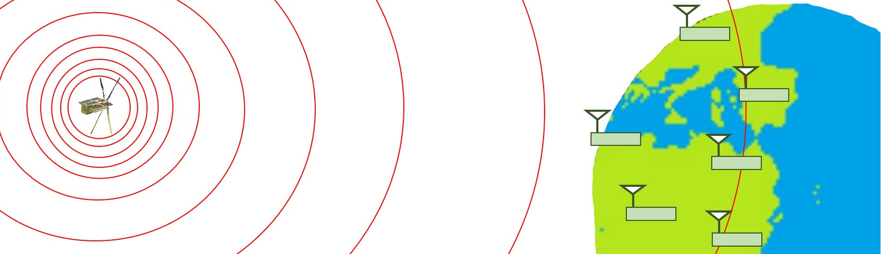
Introduction
The purpose of this project is to design a satellite UHF radio beacon system which provides:
A cost-effective system of tracking objects in the LEO environment
A better technique of uniquely identifying an object in LEO
A method of obtaining small satellite telemetry data Irrespective of a failure in any other satellite system
An alternative communications pathway for satellite control
Notes:
To address the identified problems, the design of a satellite UHF radio beacon system is proposed to provide:
A cost-effective system that can track active, End of Life and failed satellites
A better technique of uniquely identifying an object in LEO
A method of obtaining satellite telemetry or health data irrespective of a failure in any other satellite system
An alternative communications pathway for satellite control

Slide 6
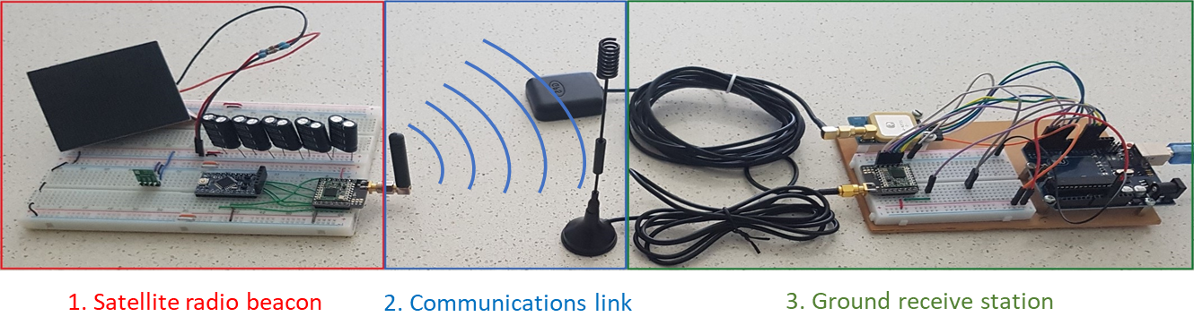
Theory of Operation
The Satellite UHF radio beacon system will be separated into 3 components:
The satellite radio beacon – A self-sustained system that can operate independently of all other satellite systems until deorbit
The communications link – It supports the reliable transfer of data between the radio beacon in LEO to a ground receive station (2000km slant range)
The ground receiving station – Can capture the transmitted data, record the precise time of arrival of the RF signals and pass data to a peripheral device.
Notes:
The Satellite UHF radio beacon system will be separated into 3 components:
The satellite radio beacon – That is a self-sustained UHF communication system that can operate independently of all other satellite systems
The communications link – that supports the reliable transfer of data for a slant range of 2000kms
The ground receiving station – which can capture the transmitted data, recording the precise time of arrival of the RF signals and passing data to a peripheral device for processing.

Slide 7
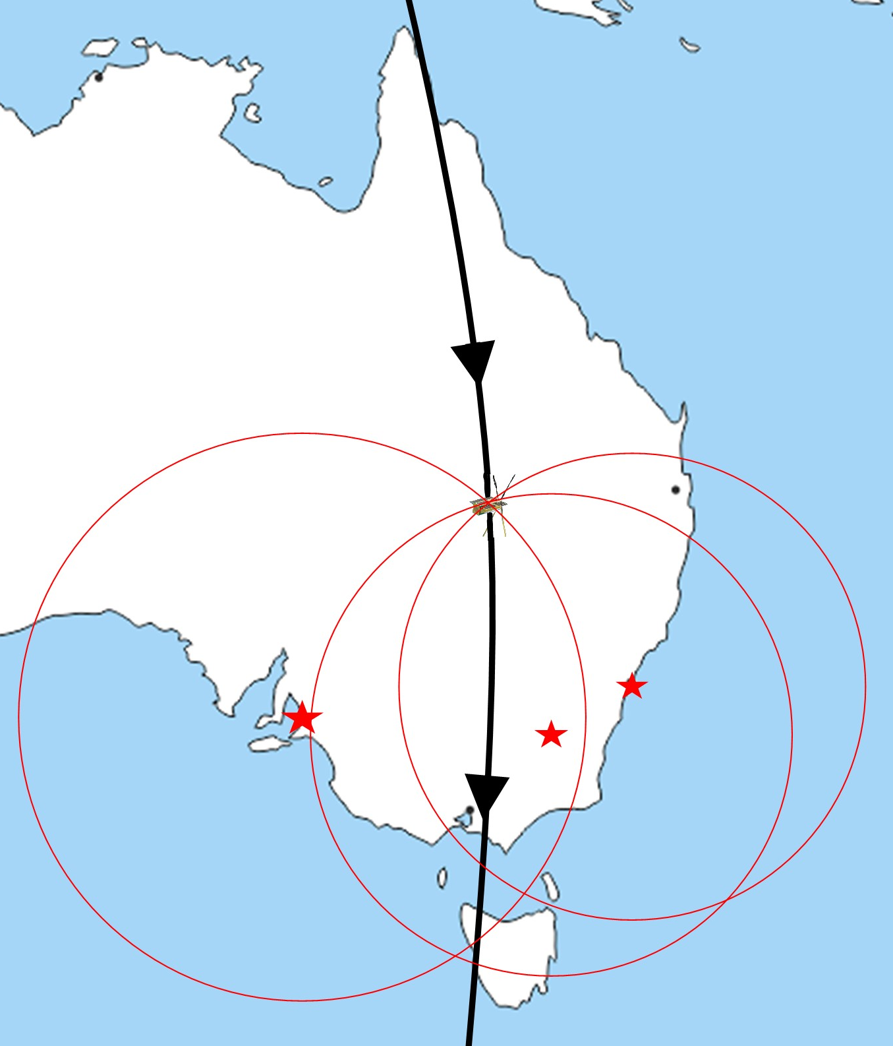
Theory of operation
The satellite beacon collects telemetry data and a unique 16-Bit address into radio packets for the periodic transmission from the UHF radio which is followed by a period where command data can be received via the radio
The data from the transmitted RF signal is collected with the measured precise time of arrival at multiple graphically dispersed ground stations which is passed along to a peripheral device for processing.
The time of arrival between the three ground stations allows for the trilateration of the satellites position using the Time Difference of Arrival (TDOA) calculation technique.
Notes:
The satellite beacon is linked with the other satellite systems to collect telemetry data and contains a unique 16-Bit address that is placed into data packets and periodically transmitted from the beacon’s UHF radio at 437MHz.
This is followed by a short period of time where command data can be received by the radio.
The transmitted data from the satellite beacon is collected with the RF signals precise time of arrival at multiple graphically dispersed ground stations.
This data is then passed along to a peripheral device where the calculation of the satellites estimated position can be determined using the time difference of arrival between three ground stations

Slide 8
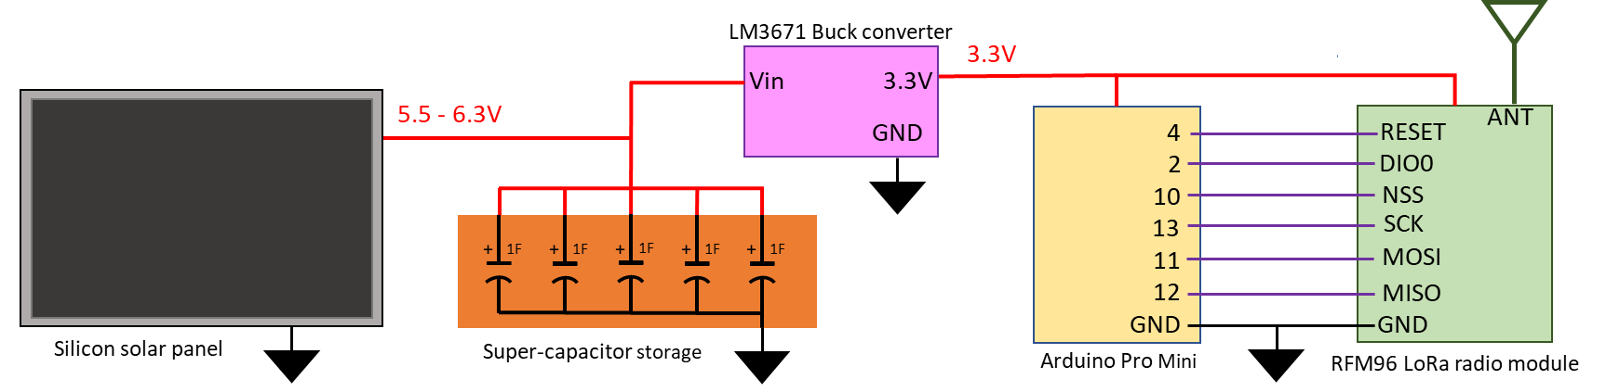
Satellite Radio Beacon
The satellite UHF radio beacon must be self-sustaining and independent of all other satellite systems
To achieve these aims the beacon must contain its own:
Processor – Based on the Arduino Pro Mini (APM) module containing an ATMEGA328P processor
Radio Transceiver –RFM96 LoRa radio module, which utilises ultra-long range spread spectrum communication techniques
Power Generation, Storage and Regulation – 0.5W monocrystalline silicon solar panel (for ground testing), a super-capacitor storage system and a DC-DC buck converter power regulator
Notes:
The satellite UHF radio beacon must be self-sustaining and independent of all other satellite systems
To achieve these aims the beacon must contain its own:
• Processor – which is based on the Arduino Pro Mini (APM) module
• Radio Transceiver – that utilises a RFM96 LoRa radio module
• Power Generation, storage and regulation – which contains silicon solar panels, a super-capacitor storage system and a buck converter for power regulation

Slide 9
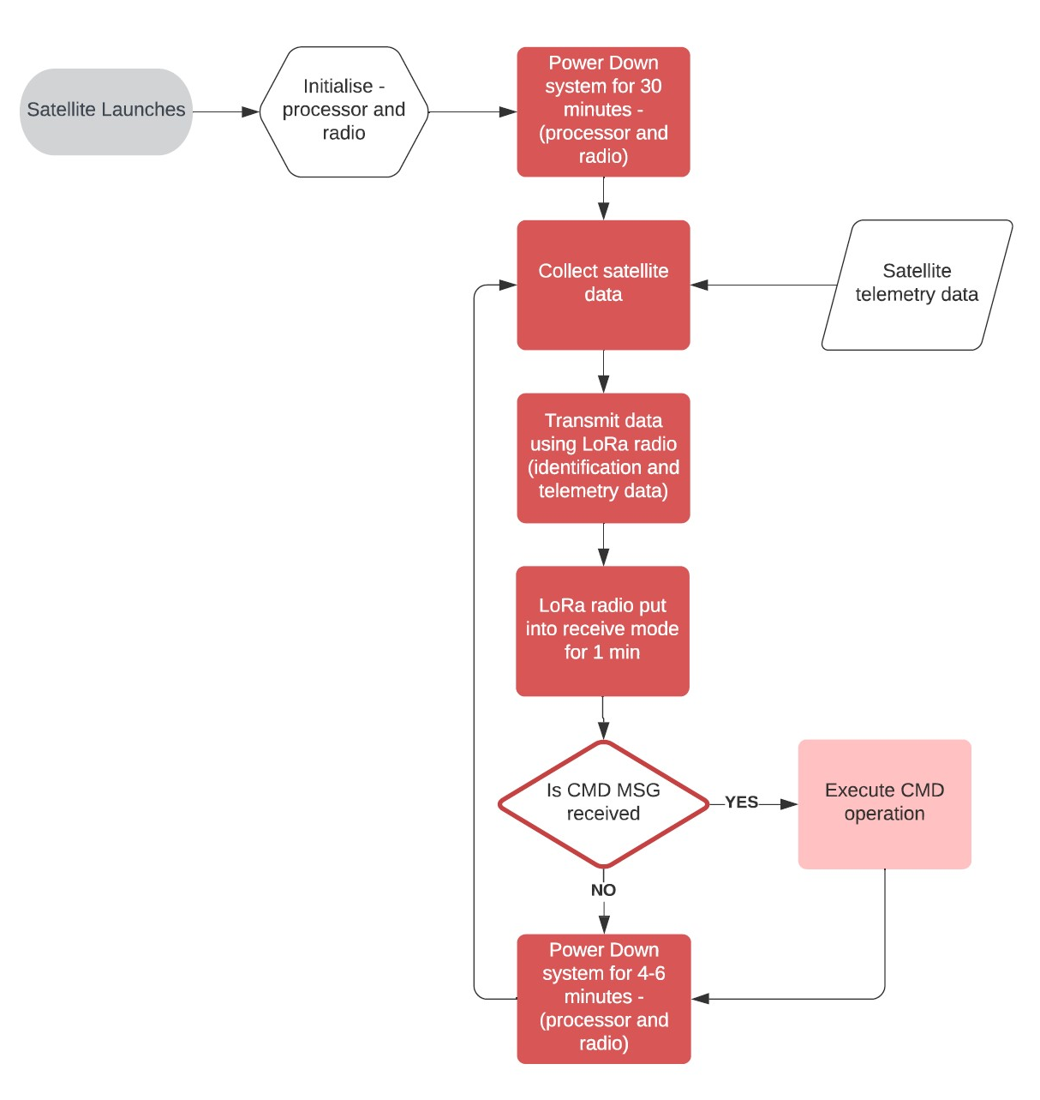
Satellite Radio beacon
The software cycle for the satellite radio beacon was developed to comply with the following requirements:
The beacon is required to maintain radio silence 30 minutes after release from the launch vehicle, (with different time lengths for different launch providers)
The radio must have a receive period in which the radio can receive a command to cease radio transmissions (required for the 435-438MHz RF spectrum as determined by ACMA and ITU)
The software cycle must contain a variable period for the power down phase to prevent transmission synchronisation between multiple satellites
Notes:
The software cycle for the radio beacon was developed to comply with the following requirements:
• The beacon is required to maintain radio silence for 30 minutes after release from the launch vehicle
• The radio must have a receive period in which the radio can receive a command to cease radio transmissions
• The software cycle must contain a variable time period for the power down phase to prevent synchronisation of transmissions

Slide 10
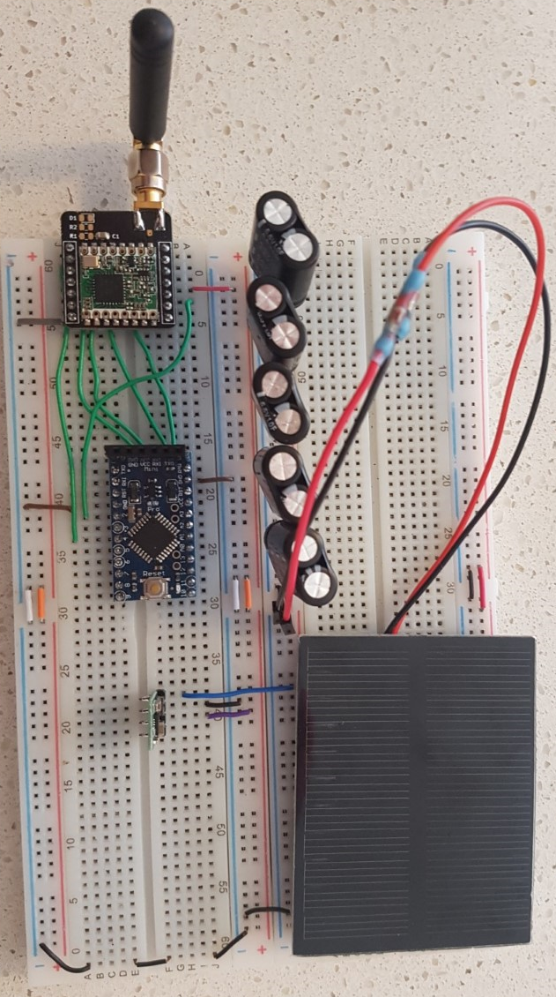
Satellite Radio beacon
The aim of the design is to minimise Size, Weight and Power (SWaP) of the satellite beacon system, in which the testing carried out on each component focussed on minimising the current consumption. The tests carried out on each component is as follows:
APM module processor – Test processor power modes
LoRa radio module – Test Radio power modes, Transmission (TX) power and data packet sizes
Power regulator – Test consumption of multiple regulator types
Ground-based solar panel – Test total system current requirements and total number of solar panels required
Capacitor-based power storage – Develop and test power storage system for system requirements
Super-capacitor storage
LoRa radio Module
APM Processor Module
DC-DC Buck converter
Silicon solar panel
Notes:
The aim of the satellite radio beacon design is to minimise Size, Weight and Power (SWaP) of the system, with minimising the current consumption of each component being the focus of testing.
The tests presented on the slide were carried out in a sequential order to determine the hardware and software configuration for the initial design of the satellite radio beacon

Slide 11
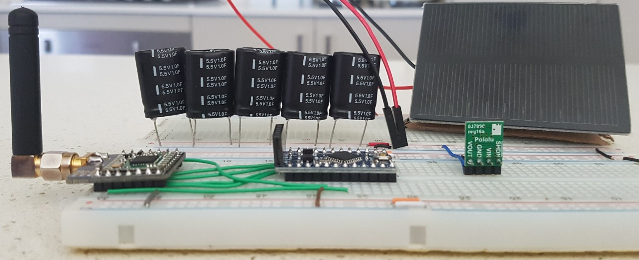
Satellite Radio beacon
The testing found methods to minimise the total beacon system current consumption:
Placing the LoRa module into sleep mode and the processor into low power mode where possible
Minimizing the receive and transmit time phase in the beacon software cycle
Reducing the TX power and data packet size to as small as possible
Additional observations were also made during the testing:
One solar panel could not support the beacon operation without an additional power source with a TX power greater than 10dBm
The super-capacitors introduce an 8 min & 20 sec delay to the system initialisation which can be utilised in the launch phase of the cycle
Several radio packets were observed to be transmitted but not received by the LoRa module (which is investigated in the communications link)
Notes:
The testing found the following methods to minimise the total beacon system current consumption:
Placing the LoRa module into sleep mode and the processor into low power mode where possible
Minimizing the receive and transmit phase in the beacon software cycle
Reducing the TX power and data packet size to as small as possible
Some additional observations were made during the testing of the satellite beacon:
one solar panel could not support the beacon operation without an additional power source with a TX power greater than 10dBm
The super-capacitors introduce an 8 minute and 20 second delay to the system initialisation which can be utilised in the launch phase of the cycle
Several radio packets were observed to be transmitted but not received by the LoRa module (which is investigated in the communications link)

Slide 12
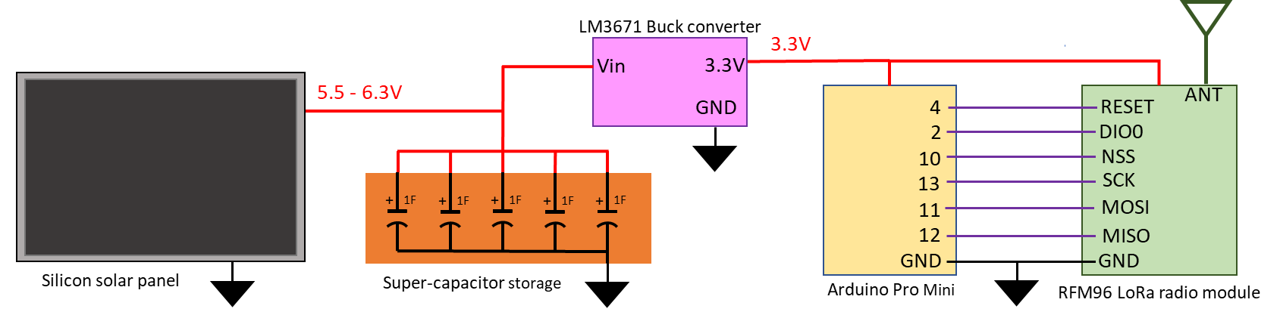
Satellite Radio beacon
The ground testing has shown that the satellite UHF radio beacon can self-sustain operation using a single silicon solar panel with the power storage system providing 74 minutes of operation when no power is being generated.
There is a combination of analogue, digital and serial connections remaining to collect telemetry data from other satellite systems with the majority of system memory remaining for the data collection and command receive software program development
Investigation into creating a PCB design and electrical component selection for space operations is required before commencing mission-readiness testing
Notes:
The ground testing has shown that the satellite UHF radio beacon can self-sustain operation using a single silicon solar panel with the power storage system providing 74 minutes of operation when no power is being generated.
There is a combination of analogue, digital and serial connections remaining to collect telemetry data from other satellite systems with most system memory remaining for the data collection and command receive software program development.
Investigation into creating a PCB design and electrical component selection for space operations is required before proceeding to mission-readiness testing

Slide 13
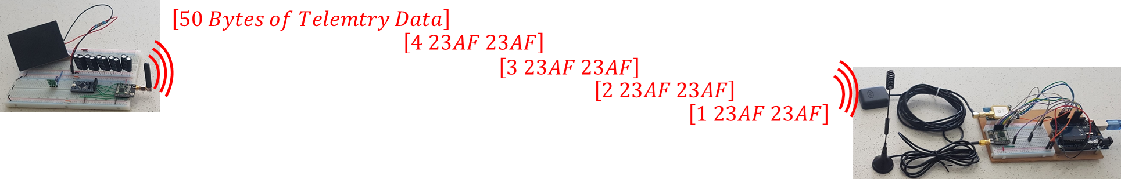
Communications Link
The parameters for the communications link testing are based upon a satellite in a sun-synchronous LEO orbit with an orbital height of 600kms and a 98° inclination.
These parameters result in the following orbital characteristics:
a 90-minute orbital period
a view window of 8-10 minutes
a slant range of between 500-2000km, which equates to a Free-Space path loss of 151.3dB
Notes:
The parameters for the communications link testing are based upon a satellite in a sun-synchronous LEO orbit with a 600kms height and a 98° inclination.
These parameters result in the communications link have a maximum slant range of 2000km which equates to a 151.3dB Free-space path loss

Slide 14

Communications Link
The first investigation was to determine why the RFM96 LoRa radio module was not receiving the transmitted data packets. The testing carried out was unable to be determine the reasons due to the proprietary nature of the LoRa module software and no methods could be found to bypass the LoRa receive process.
The testing process analysed over 1 million data packets with the receiving LoRa module dropping nearly 1% of the data packets transmitted which matches the RFM96 data sheet. The high PER of the LoRa radio module found during testing caused a change in the data transmission method in which the information will be split into 4 identification packets followed by a separate telemetry packet .
Notes:
The first investigation carried out was to determine why the LoRa radio module was not receiving the transmitted data packets.
The testing carried out was unable to determine the reason because of the proprietary nature of the LoRa software and no methods could be found to bypass the LoRa receive process.
The high packet error rate of the LoRa module found during testing caused a change in the data transmission method in which the information will be split into 4 sequential identification packets followed by a separate telemetry data packet

Slide 15
Communications Link
The next step in the testing procedure was to verify the reliable transfer over the UHF communications link (2000km slant range, 151.3dB FSPL) and determine the LoRa radio module software settings and TX power.
The receiver sensitivity was estimated using the LoRa modem calculator tool (available from Semtech) with the link budget verified by hand calculations followed with ground-based testing for a transmit power of 5, 10, 15 and 20 dBm.
The Lora module radio settings used for the testing were obtained from the open-source RadioHead library which contains a set of default settings:
Notes:
The next step in the testing procedure was to verify the reliable transfer of data over the UHF communications link and determine the LoRa radio module settings and TX power
The receiver sensitivity was firstly estimated using the LoRa modem calculator tool followed by hand calculating the communications link budget.
The calculations were verified with the results of the ground-based testing

Slide 16
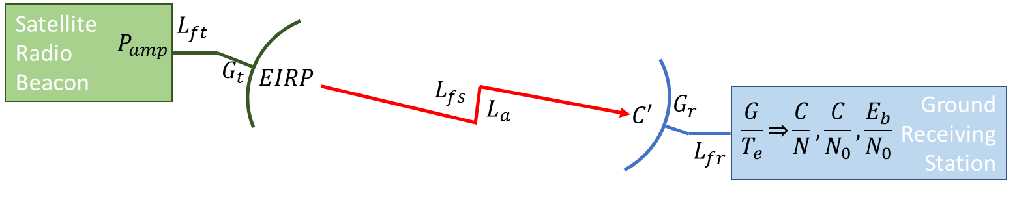
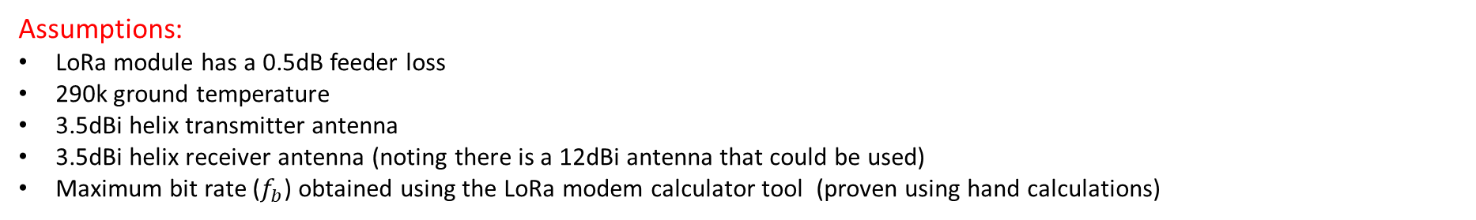
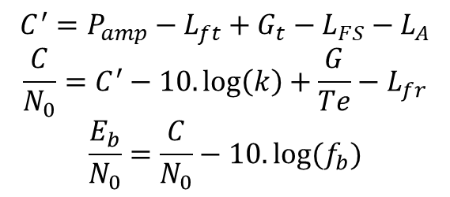
Communications Link
Link Budget Calculations
$$C^{′}=P_{amp}−L_{ft}+G_{t}−L_{FS}−L_{A}$$
$$\frac{C}{N_{0}}=C^{′}−10.\log\left(k\right)+\frac{G}{Te}−L_{fr}$$
$$\frac{E_{b}}{N_{0}}=\frac{C}{N_{0}}−10.log⁡(f_{b})$$
Assumptions:
LoRa module has a 0.5dB feeder loss
290k ground temperature
3.5dBi helix transmitter antenna
3.5dBi helix receiver antenna (noting there is a 12dBi antenna that could be used)
Maximum bit rate ($f_{b}$) obtained using the LoRa modem calculator tool (proven using hand calculations)
Notes:
This slide presents the simplified equations used for the link budget calculation which were repeated for the 0, 2 and 3 default radio settings with various TX powers.

Slide 17
Communications Link
The ground-based testing was carried out by physically connecting two LoRa modules using a set of coaxial cables (RG174 cable, -60dB/m @ 437MHz) and attenuators.
The A and B attenuators are slowly increased until the receiver stops collecting consistent data which represent the maximum value of FSPL for which reliable data is received
The test was repeated for 5dBm, 10dBm, 15dBm and 20dBm transmit power with the (0), (2) and (3) default RadioHead settings.
Notes:
The ground-based testing was carried out by physically connecting two LoRa modules using a set of coaxial cables and attenuators.
The total attenuation was slowly increased until the receiver stops collecting consistent data which represents the maximum value of FSPL for which reliable data is received

Slide 18
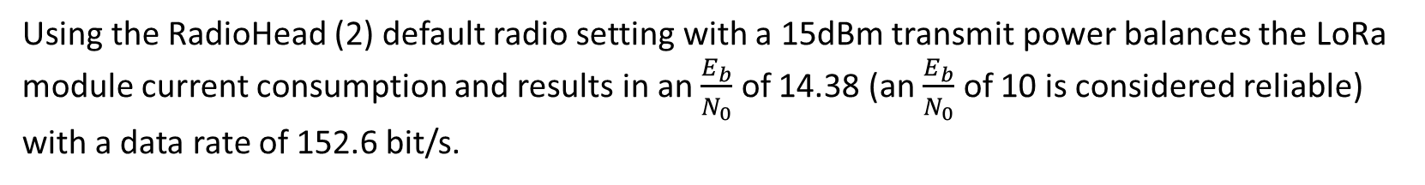
Communications Link
The calculated values for the link budget are presented below
The results from the ground testing are shown below
Using the RadioHead (2) default radio setting with a 15dBm transmit power balances the LoRa module current consumption and results in an $\frac{E_{b}}{N_{0}}$ of 14.38 (an $\frac{E_{b}}{N_{0}}$ of 10 is considered reliable) with a data rate of 152.6 bit/s.
Notes:
The results of the link budget calculations and ground testing show that a reliable communications link can be supported if the LoRa module uses the RadioHead (2) default settings with a 15dBm TX power.
This results in a 2000km communications link budget having an Eb/No of 14.38 which allows a margin for unaccounted and future losses.

Slide 19
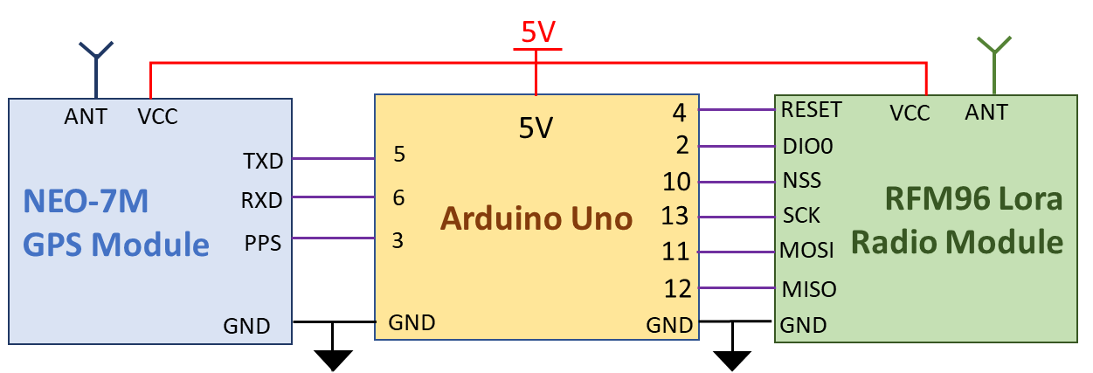
Ground Receiving Station
The ground receiving station must be able to capture the transmitted data, record the precise time of arrival of the RF signals, determine its global location and pass data to a peripheral device.
To achieve these aims the ground receiving station contains:
Processor module – Arduino Uno module with an ATMEGA328P processor and 16MHz external oscillator
Radio Module – RFM96 LoRa radio module with 410-525MHz frequency range
GPS Module – U-Blox NEO-7M GNSS module with a Pulse-per-Second signal synchronised to Coordinated Universal Time (UTC)

Slide 20
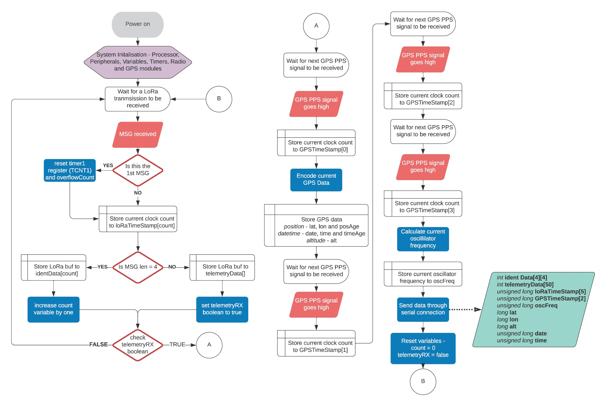
Ground receiving station
Ground receiving station software cycle
The ground station captures the data from each received data packet and records the number of processor cycle cycles that have occurred (the first Rx’ed signal resets the clock count)
After the telemetry data is received, it captures the GNSS data (with the current UTC and global position) and the number of clock cycles at the next PPS pulse
The number of clock cycles between the next 3 GNSS PPS signals are collected and averaged to determine the current frequency of the external oscillator (used to calculate the length of the clock cycle)
The length of clock cycles is used to calculate the time of arrival of each received RF signal with reference to the recorded current UTC
The collected data is then passed through the serial connection to a peripheral device for post processing

Slide 21
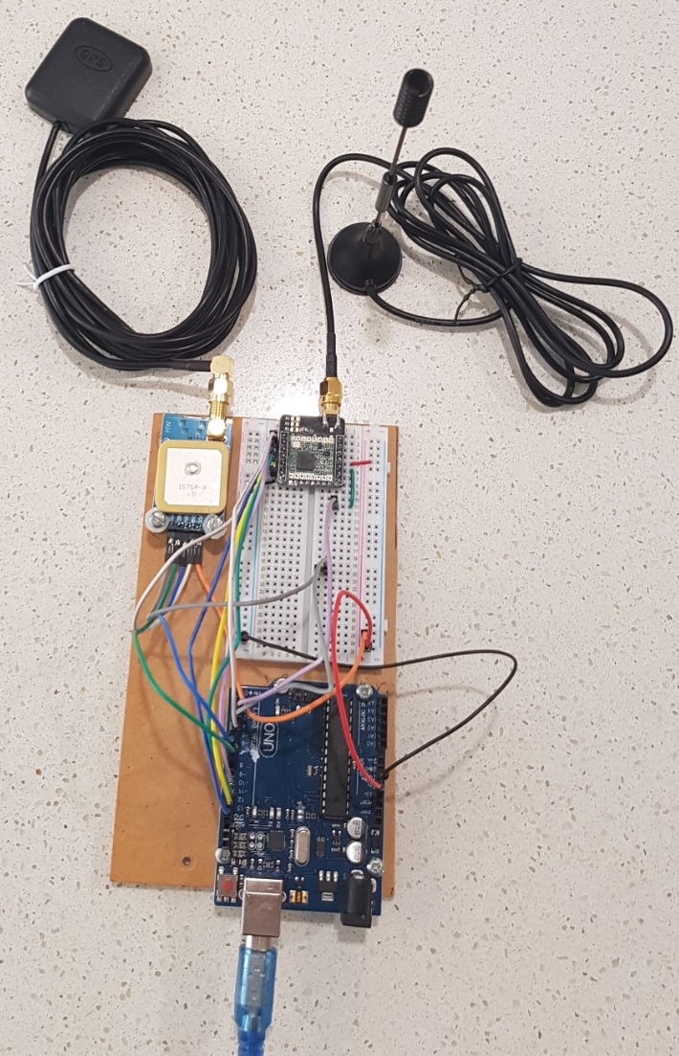
Ground receiving station
The high resolution of the timing function built into the Arduino IDE (4ms) led to the development of using the clock cycles of the ATMEGA328P processor to measure time.
Time is measured by counting of the number of clock cycles that occur between events using the processor 16-Bit Timer1 with the resolution of each clock cycle being 62.5ns (16MHz external oscillator with no external influences)
The identified sources of uncertainty in the time measurement that required testing were:
The resolution of using the Arduino built-in timing function, micros() – led to using the clock counting
The number of clock cycles taken to carry out a Interrupt Service Routine (ISR)
The drift in the oscillator frequency due to temperature, tolerances and other sources of error
The tolerance of the GNSS PPS signal
The accuracy of the ground station GNSS position
The time taken for the LoRa module software to process and make the data available

Slide 22
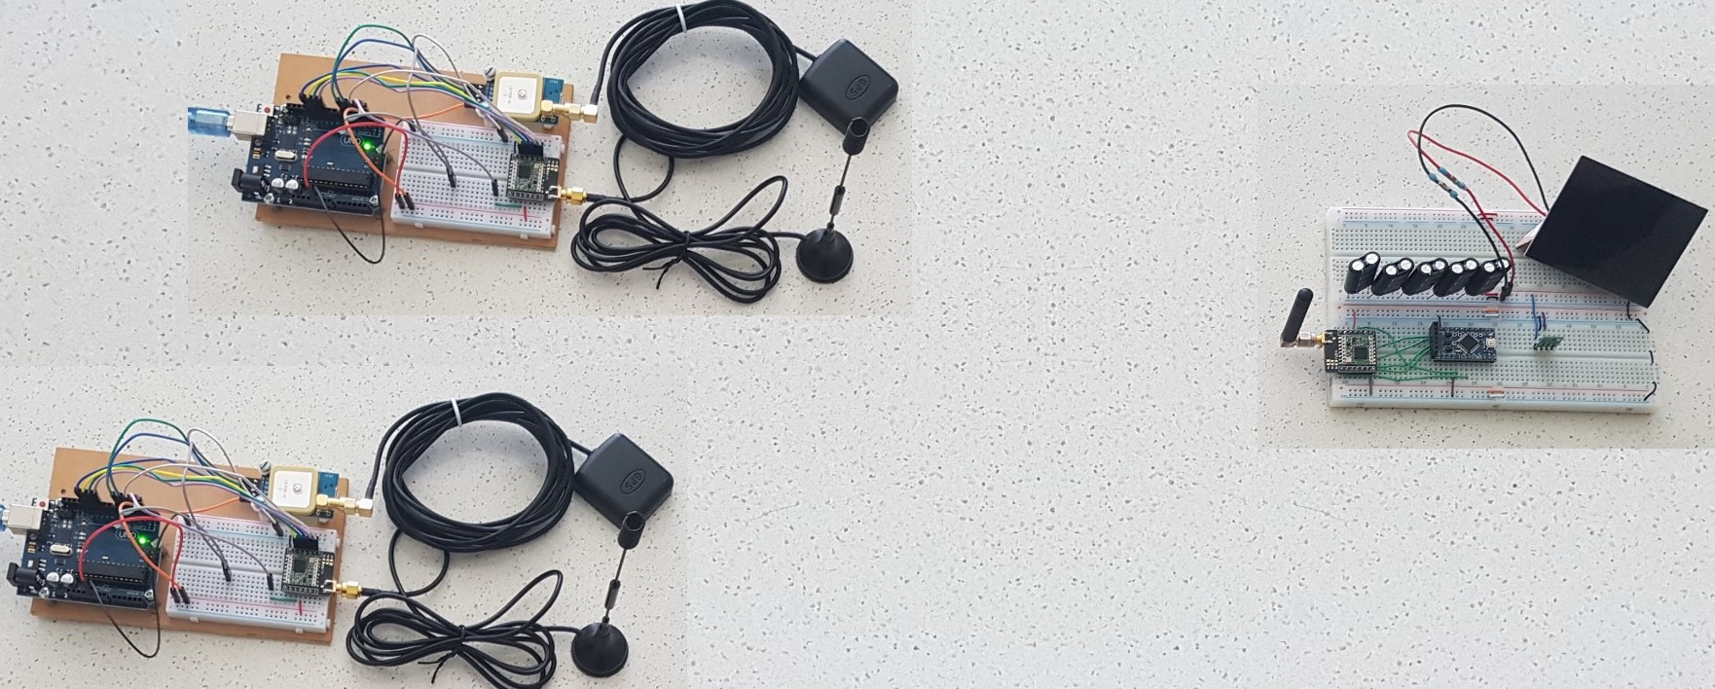
Ground receiving station
The testing of the ground station measured the following uncertainty in timing or distance measurement:
±3 clock cycles in using the TIMER1 clock counting technique, equates to 56.5m
A negligible error in averaging the oscillator frequency, <2fs
30ns tolerance of the GNSS PPS signal, equates to 9m
Tolerance of the GNSS position, 10m
5µs difference in LoRa processing time between 2 modules, 1.2km
The total expected uncertainty when measuring the difference of time arrival between two ground stations was estimated to be 5.25µs.
This equates to an error of 1.58kms when estimating the position using the DTOA ranging technique.

Slide 23
Ground receiving station
During the final verification testing, the uncertainty in determining the time difference of arrival was found to be 1.5ms to 1.7ms which is a TDOA distance calculation error of 450-510ms.
The mostly likely cause of the increase in uncertainty is the method in which the clock counting ISR is implemented in the more complex ground station software cycle.
Further investigation to reduce the uncertainty in the time measurement process, with a focus on utilising a timer capture mode, is required before a reliable TDOA algorithm can be used to estimate the satellites position.

Slide 24
Conclusion
The aim of this project was to produce an initial prototype design for a self-contained and independent radio beacon that can transfer data from a small satellite in a low earth orbit. The project was extended to include a prototype design for the ground receive station with a tracking function.
The Satellite radio beacon prototype design has been tested and verified to be capable of:
Operating with no input from any other satellite system
Collecting telemetry data from other satellite systems
Sustaining beacon operation using a singular solar panel
Executing a command received from a ground station
Reliably transferring data reliably for distance of 2000km
Notes:
The aim of this project was to produce an initial prototype design for a self-contained and independent radio beacon that can transfer data from a small satellite in a low earth orbit.
The project was extended to include a prototype design for a ground receiving station with a tracking function.
The satellite radio beacon prototype design has been tested and verified to be capable of
• Operating with no input from any other satellite system
• Collecting telemetry data from other satellite systems
• Sustaining beacon operation using a singular solar panel
• Executing a command received from a ground station
• Reliably transferring data for distance of 2000km

Slide 25
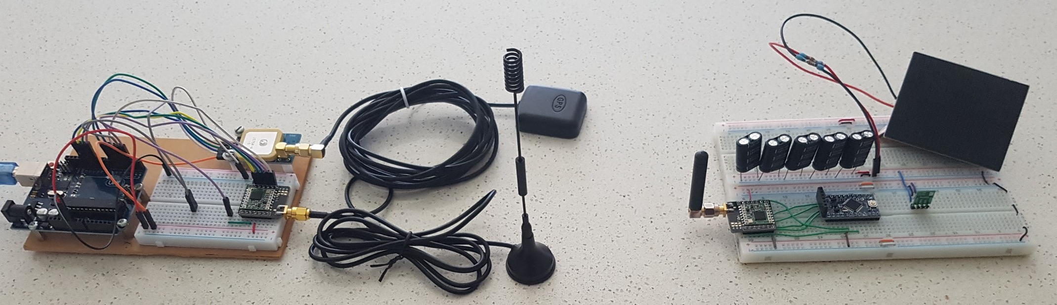
Conclusion
The ground station protype design was capable of transmitting command data to the satellite beacon and receiving the transmitted satellite identification and telemetry data. The testing carried out indicated that the time difference of arrival calculation of the satellite position had an uncertainty of 1.5kms but the final verification testing revealed an uncertainty of 450-510kms.
The initial design for the small satellite UHF radio beacon system has proven the concept for the small satellite Identification, Telemetry and Control but further investigation of the ground receiving station is required to obtain a reliable and accurate tracking function
Notes:
The ground receiving station protype design was capable of transmitting command data to the satellite beacon and receiving the transmitted identification and telemetry data.
The testing carried out indicated that the time difference of arrival calculation of the satellites position had an uncertainty of 1.5kms but the final verification testing revealed an uncertainty of 450-510kms.
The initial design for the small satellite UHF radio beacon system has proven the concept for the small satellite Identification, Telemetry and Control but further investigation of the ground receiving station is required to obtain a reliable and accurate tracking function

Slide 26
Recommendations
It is suspected that the implementation of the processor clock counting method in the ground station software causes the large increase in time measurement uncertainty leading to the sizeable uncertainty in position estimation.
If the uncertainty of the satellites position can be reduced to an acceptable level then development of the system can be continued to:
Implement a TDOA algorithm that calculates estimated position based on Latitude/Longitude position
Develop a user interface program for the ground receiving station
Develop a server system for the collection and processing of ground station gathered data
Produce a satellite radio beacon design ready for space mission readiness testing
Notes:
It is suspected that the implementation of the processor clock counting method in the ground station software causes the large increase in time measurement uncertainty leading to the sizeable uncertainty in position estimation.
If the uncertainty of the satellites position can be reduced to an acceptable level, then development of the system can be continued to:
• Implement a TDOA algorithm that calculates estimated position based on Latitude/Longitude position
• Develop a user interface program for the ground receiving station
• Develop a server system for the collection and processing of ground station gathered data
• Produce a satellite radio beacon design ready for space operation testing

